Slide 1



IoT Project Title
Energy Monitor
DEPARTMENT OF ELECTRONICS AND COMMUNICATION ENGINEERING
22GCL12 – FOUNDATION LAB – Electrical, IoT and Web
(Internet of Things)
PRESENTED BY
25AUR017 – Priyadharshika K
25AUR018 – Ragha Mruthika M
25AUR019 – Sabariviknesh S R
25AUR020 – Sanjay N
DATE: 12.11.2025
1

Slide 2
OBJECTIVE
The objective of this project is to design and implement an automated system capable of accurately detecting and monitoring room occupancy in real time. The system aims to enhance space utilization, improve energy efficiency, and support safety and security operations by employing sensor-based or vision-based technologies. It will capture occupancy data, process it using appropriate algorithms, and make this information available for integration with building management or automation systems. The solution should deliver high reliability, low latency, and minimal false detections while operating under diverse environmental conditions.
2

Slide 3
HARDWARE AND SOFTWARE REQUIREMENTS
Hardware used
Software used
Arduino Board (e.g., Arduino Uno)
IR Sensor Modules (Transmitter and Receiver pairs)
LEDs (Indicator LEDs)
Resistors (for LEDs and sensor signal conditioning)
Breadboard
Jumper Wires (Male-to-Male, Male-to-Female as required)
Power Supply/USB Cable for Arduino
Arduino IDE
Arduino Programming Language (C/C++ based)
Serial Monitor (for debugging and testing)
CopperCAM
3

Slide 4
BLOCK DIAGRAM
IR - 1
IR - 2
ARDUINO CLOUD
POWER SUPPLY
ESP 32
LED - 1
LED - 2
LED - 3
LED - 4
4

Slide 5
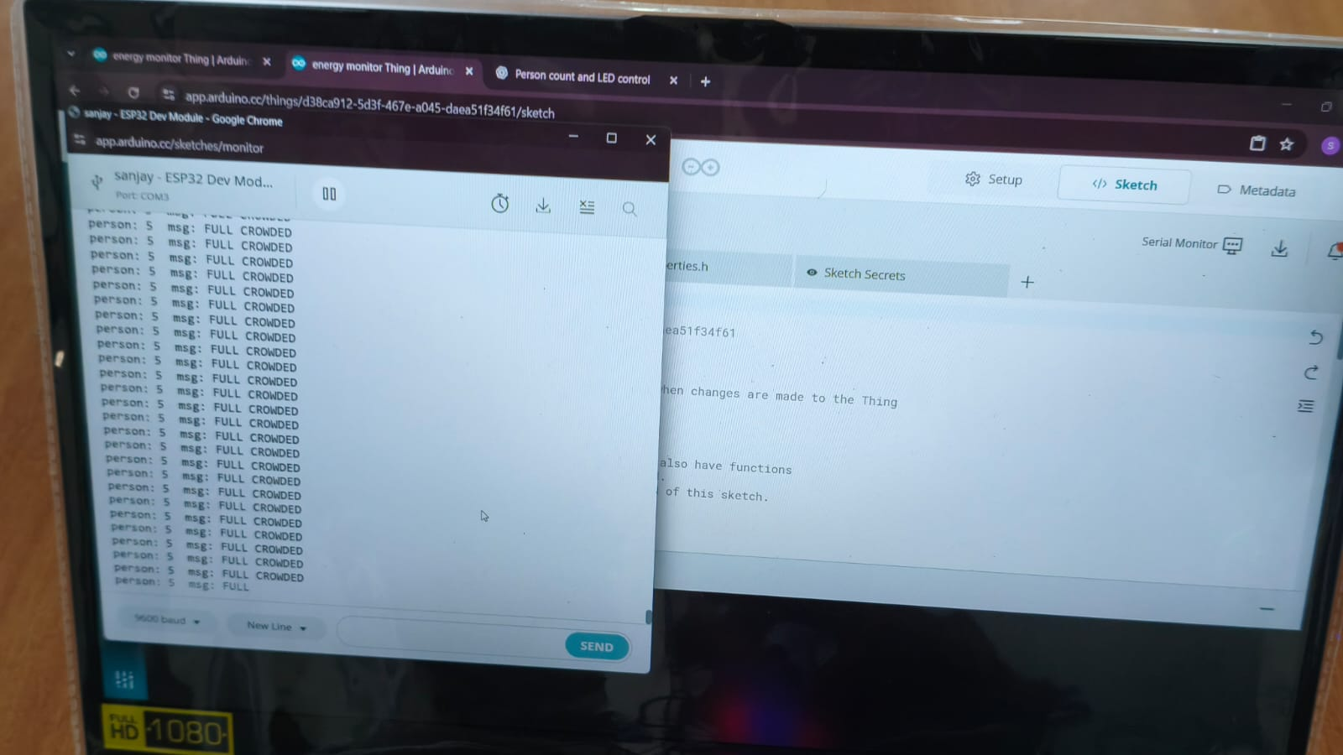
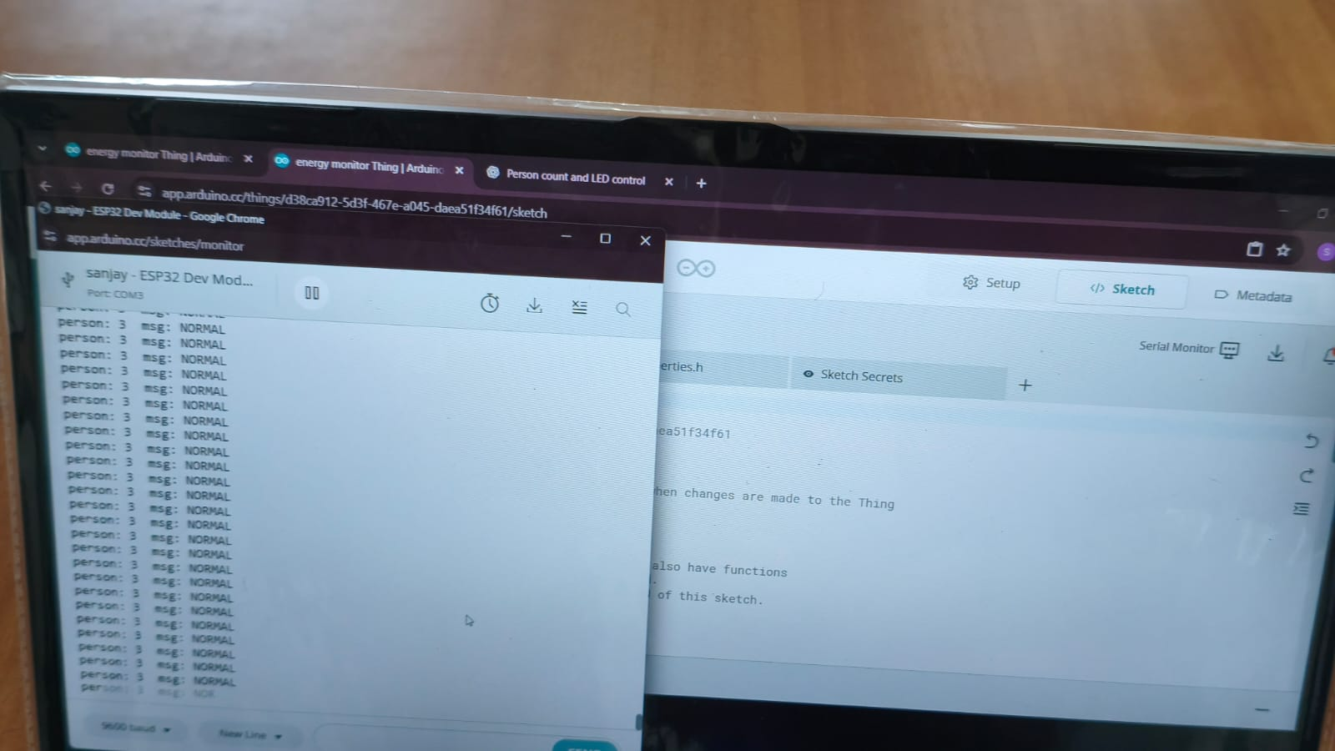
SERIAL MONITOR OUTPUT
5

Slide 6
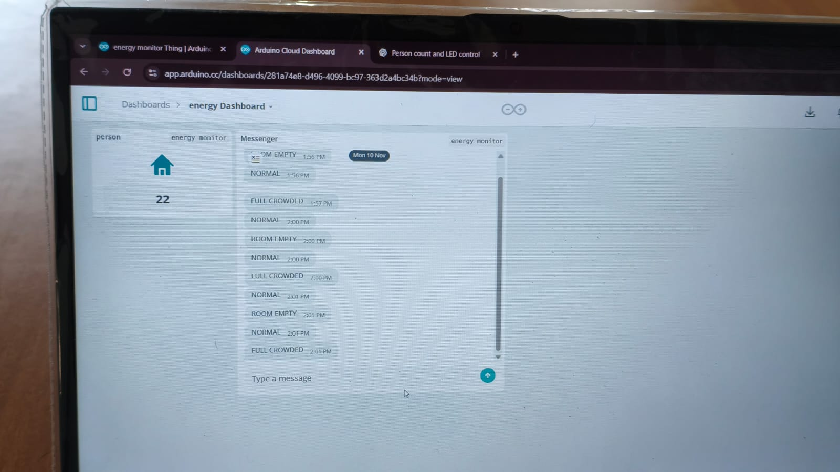
DASHBOARD
6

Slide 7
CONCLUSION
The Automatic Room Occupancy Detector successfully demonstrates an efficient and cost-effective approach to monitoring real-time occupancy using IR sensors and an Arduino-based control system. By integrating hardware components such as IR sensor modules, LEDs, and a microcontroller with a simple yet reliable software algorithm, the system is able to detect entry and exit events and maintain an accurate occupancy count. The project highlights how low-cost embedded solutions can support improved energy management, security, and space utilization within buildings. Overall, the prototype validates the feasibility of deploying sensor-driven automation to enhance operational efficiency and establish a foundation for more advanced smart-room applications.
7

Slide 8
THANK YOU

